Slide 1
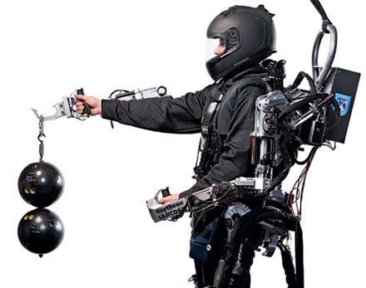
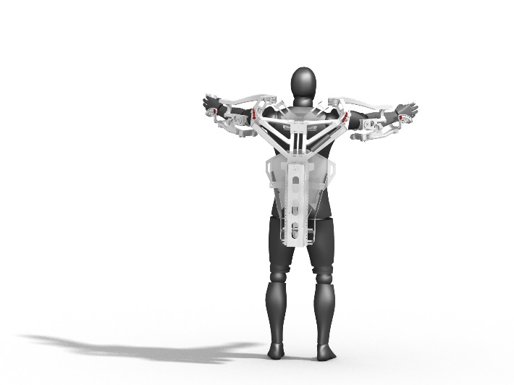
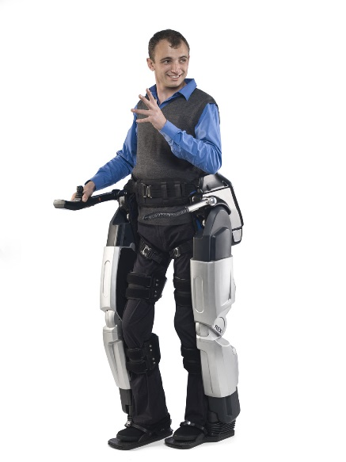
Exoskeletons
Aydin Tekin
Notes:
Prof. Dr. Max Mustermann | Name of Faculty
1

Slide 2
Structure
Motivation
Use cases
Variation of exoskeletons
Lower body
eLegs
LOPES
Honda Walking Assist Device
Upper body
ExoHand
XOS 2
Full body
HAL-5
BLEEX
HULC
Challenges
Conclusion

Slide 3
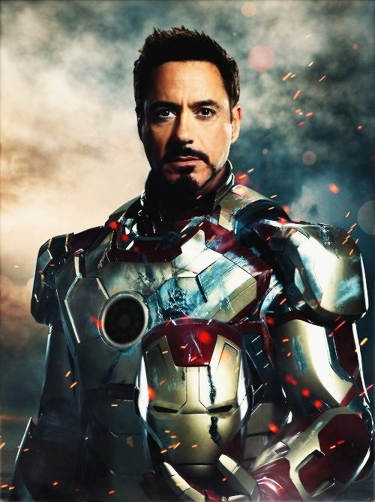

Slide 4
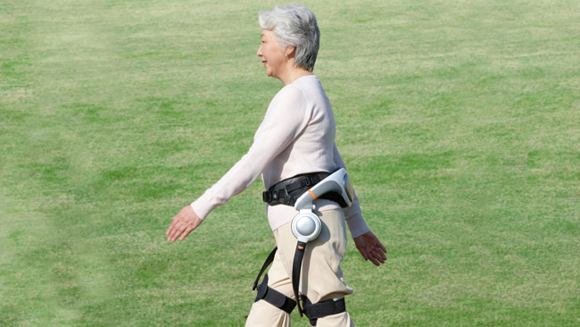
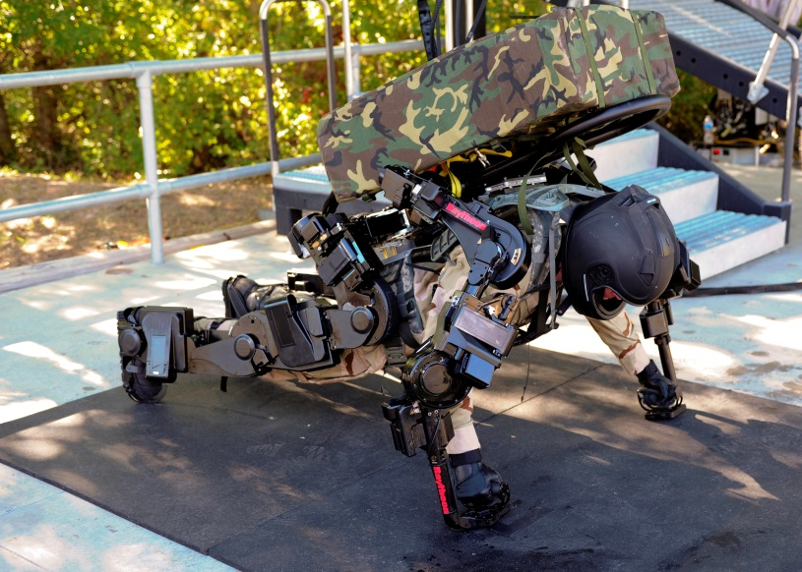
Motivation
Made to support humans
Faster
Stronger
Durable
Alleviate the effects of demographic changes
No need for an complex AI

Slide 5
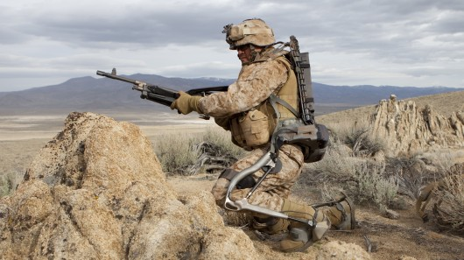
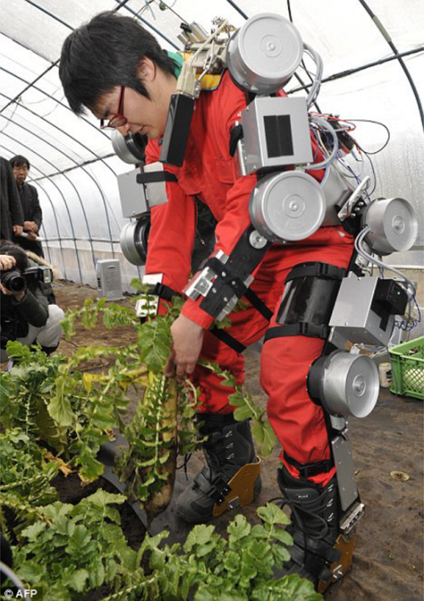
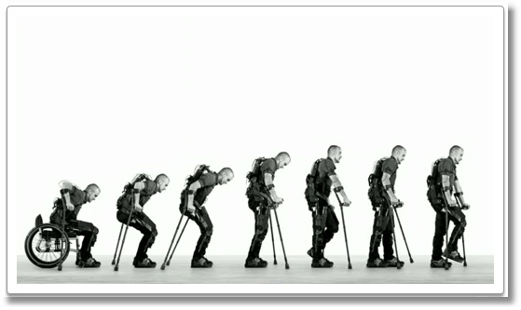
Use cases
medical
rehabilitation
daily support
military
supply
weaponary
industrial
agriculturar sector
chain-working
entertainment industry

Slide 6
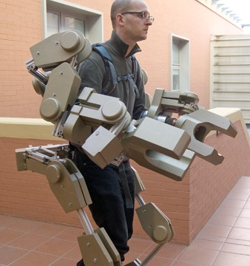
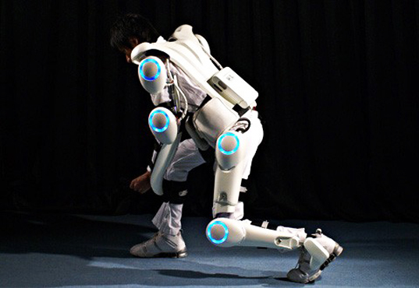
Variation of exoskeletons
Lower body extremity exoskeletons
eLegs/Ekso
LOPES
Honda Walking Assist Device
Upper body extremity exoskeletons
ExoHand
XOS 2
Full body exoskeletons
HAL-5
BLEEX
HULC

Slide 7
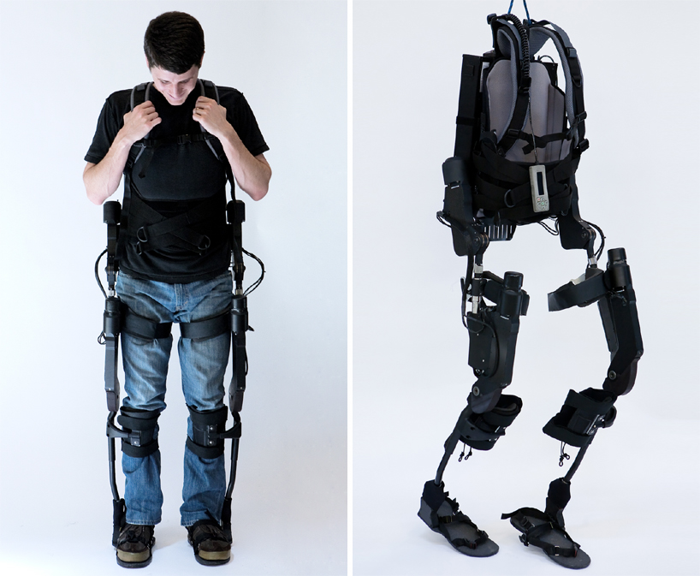
eLegs/Ekso
Developed by Berkeley Bionics, USA (now Ekso Bionics)
Runs up to 6 hours
Mostly used for rehabilitation
System control adapted by self-learning algorithm
-> users have to “train” with it, before using properly
Shiqian Wang et al 2011

Slide 8
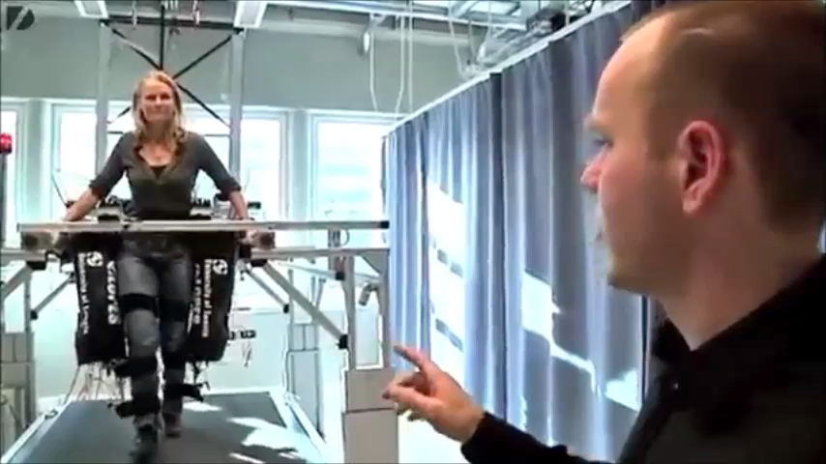
LOPES
Lower extremity powered exoskeleton developed by the University of Twente, Netherlands
8 DoF
Used in rehabilitation centers
Stationary system
Controlled by an operator
Jan F.Veneman/Rik Kruidhof et al 2007

Slide 9
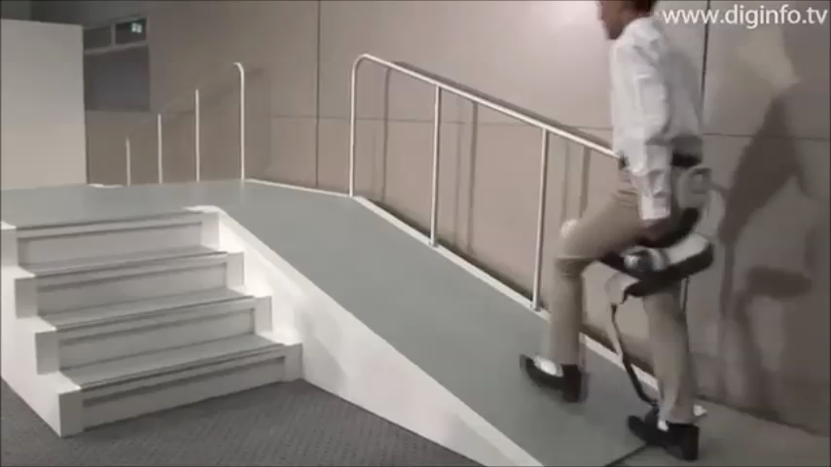
Honda Walking Assist Device
Developed by Honda, Japan
Weight 8 kg
Runs up to 4 hours
Use cases
Manufacturing tasks
Daily life
Medical rehabilitation
Robert Bogue et al 2009

Slide 10
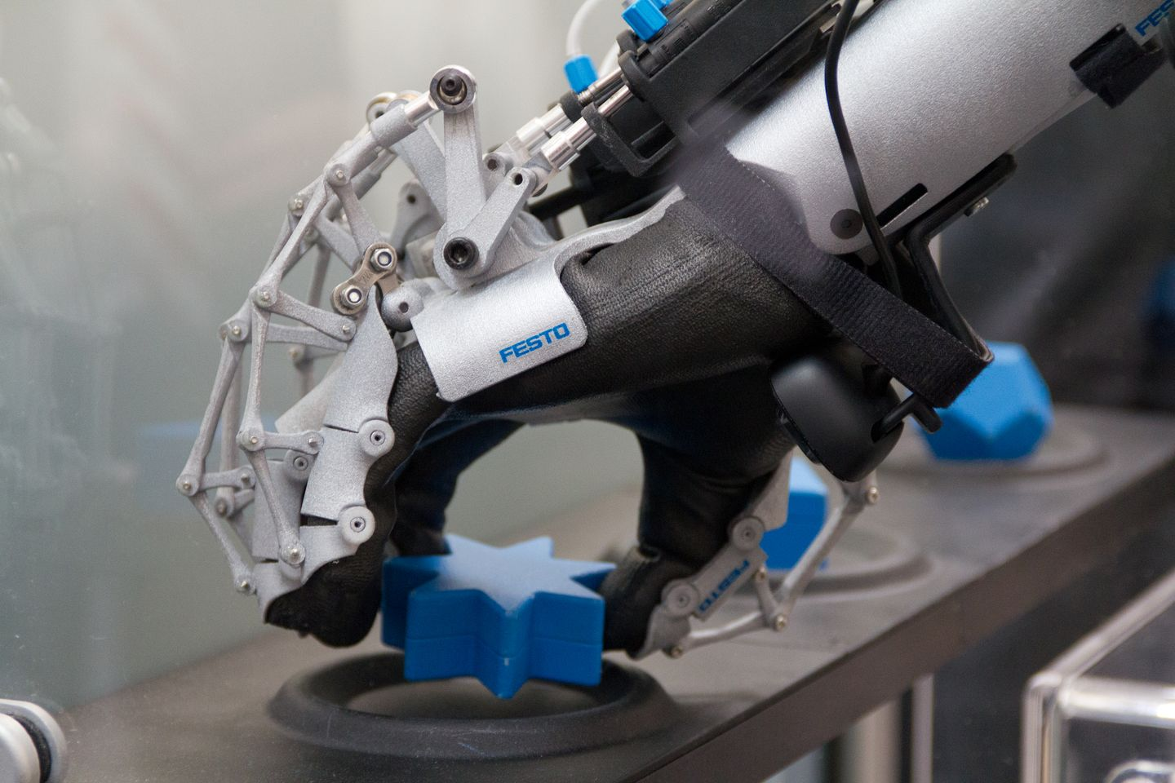
ExoHand
Designed by Festo, Germany
Several applications
Industrial
Medical
Entertainment industry
System is based on force-feedback
Inseong Jo et al 2013

Slide 11
XOS 2
Developed by Sarcos/Raytheon, USA
Can lift up to 90 kg
Mechanics based on wires
Highly agile
“can replace 3 soldiers”
Main use case
Military
Robert Bogue et al 2009

Slide 12
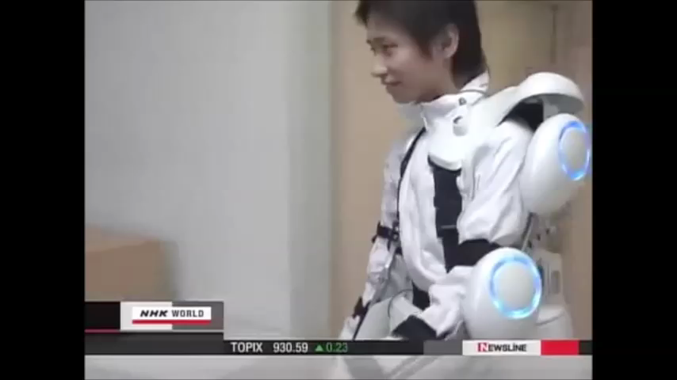
HAL-5
Hybrid Assistive Limb
Developed by Cyberdyne, Japan
can lift up to 70 kg
180 kg leg-press
first ISO 13485-certificated exoskeleton
EMG-signals
usecases
fukushima
medical
agricultural sector
Eric Guizzo/Harry Goldstein et al 2005

Slide 13
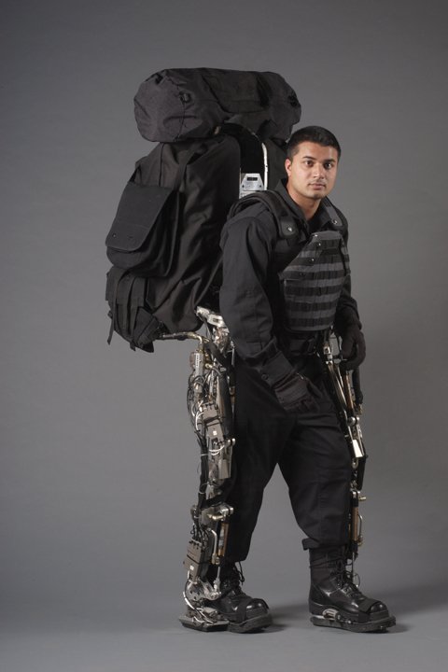
BLEEX
Berkeley Lower Extremity Exoskeleton developed by University of California, USA
Features high speed (up to 2 m/s)
7 DoF
Lifts up to 75 kg
Weighs only 14 kg
Very agile
Designed for military applications
Brian Dellon et al 2007

Slide 14
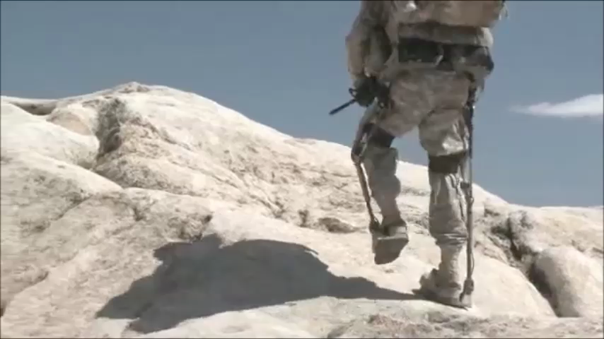
HULC
Human Universal Load Carrier developed by Lockheed Martin, USA
Successor of BLEEX
Lifts up to 90 kg
One battery load - 8 hours
Current experimental platform of the US army
Yang Wang et al 2010

Slide 15
Challenges
Power supply
Electrical vs fuels
Durability
weight
Sensors
Resolution
Real-time requirements
Robustness
Human-skeleton interaction
Adaptive and learnable control mechanisms
Agility
Security

Slide 16
Conclusion
New pioneering sector
Versatile (numerous applications and use cases)
Most of present exoskeleton designs not elaborate enough
Too slow
Too weak
Rarely used in military/industry
Many challenges/disadvantages have to be addressed

Slide 17
Sources
Exoskeletons and robotic prosthetics: a review of recent developments http://www.emeraldinsight.com/journals.htm?articleid=1806007&show=html Lower extremity exoskeletons and active orthoses: challenges and state-of-the-art http://ieeexplore.ieee.org/lpdocs/epic03/wrapper.htm?arnumber=4456745 The rise of the body bots [robotic exoskeletons] http://ieeexplore.ieee.org/xpls/abs_all.jsp?arnumber=1515961 Wearable Power-Assist Locomotor (WPAL) for supporting upright walking in persons with paraplegia http://iospress.metapress.com/content/t508g4124v867r36/ On the mechanical design of the Berkeley Lower Extremity Exoskeleton (BLEEX) http://ieeexplore.ieee.org/xpls/abs_all.jsp?arnumber=1545453 Exoskeletons for human power augmentation http://ieeexplore.ieee.org/xpls/abs_all.jsp?arnumber=1545451 Brown, P., Jones, D., Singh, S. K., and Rosen, J. M.The exoskeleton glove for control of paralyzed hands.In Proceedings of the IEEE International Conference onRobotics and Automation, Atlanta, GA, USA, 1993, vol. 1,pp. 642-647. Naruse, K., Kawai, S., Yokoi, H., and Kakazu, Y. Devel-opment of wearable exoskeleton power assist sys-tem for lower back support. In Proceedings of theIEEE/RSJ International Conference on Intelligent Robotsand Systems, Las Vegas, Nevada, USA, 2003, vol. 3,pp. 3630-3635. The RoboKnee: an exoskeleton for enhancing strength and endurance during walking http://ieeexplore.ieee.org/xpls/abs_all.jsp?arnumber=1307425 Design and evaluation of the LOPES exoskeleton robot for interactive gait rehabilitation http://ieeexplore.ieee.org/xpls/abs_all.jsp?arnumber=4303113

Slide 18
Sources
Development and control of a 'soft-actuated'exoskeleton for use in physiotherapy and training http://link.springer.com/article/10.1023/A:1024484615192 Robot assisted gait training with active leg exoskeleton (ALEX) http://ieeexplore.ieee.org/xpls/abs_all.jsp?arnumber=4663875
Design of a haptic arm exoskeleton for training and rehabilitation http://ieeexplore.ieee.org/xpls/abs_all.jsp?arnumber=1642690 Development of a lightweight, underactuated exoskeleton for load carrying augmentation http://ieeexplore.ieee.org/xpls/abs_all.jsp?arnumber=1642234 Multi-fingered exoskeleton haptic device using passive force feedback for dexterous teleoperation http://ieeexplore.ieee.org/xpls/abs_all.jsp?arnumber=1041713

